Slide 1
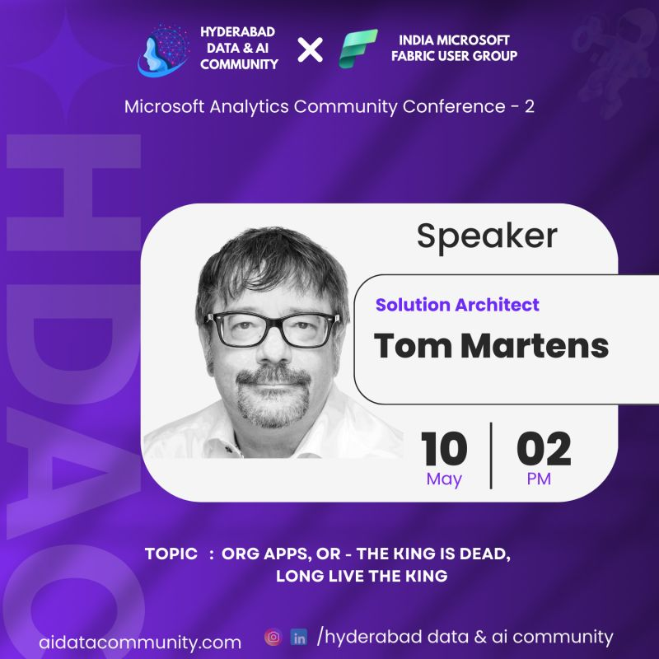
Org Apps
The king is dead, long live the king
Tom Martens @ Microsoft Analytics Community Conference
2025-05-10

Slide 2
Content
Who I am
What this session is about
Live Demo
Workspace apps vs Org apps
What we have to consider

Slide 3

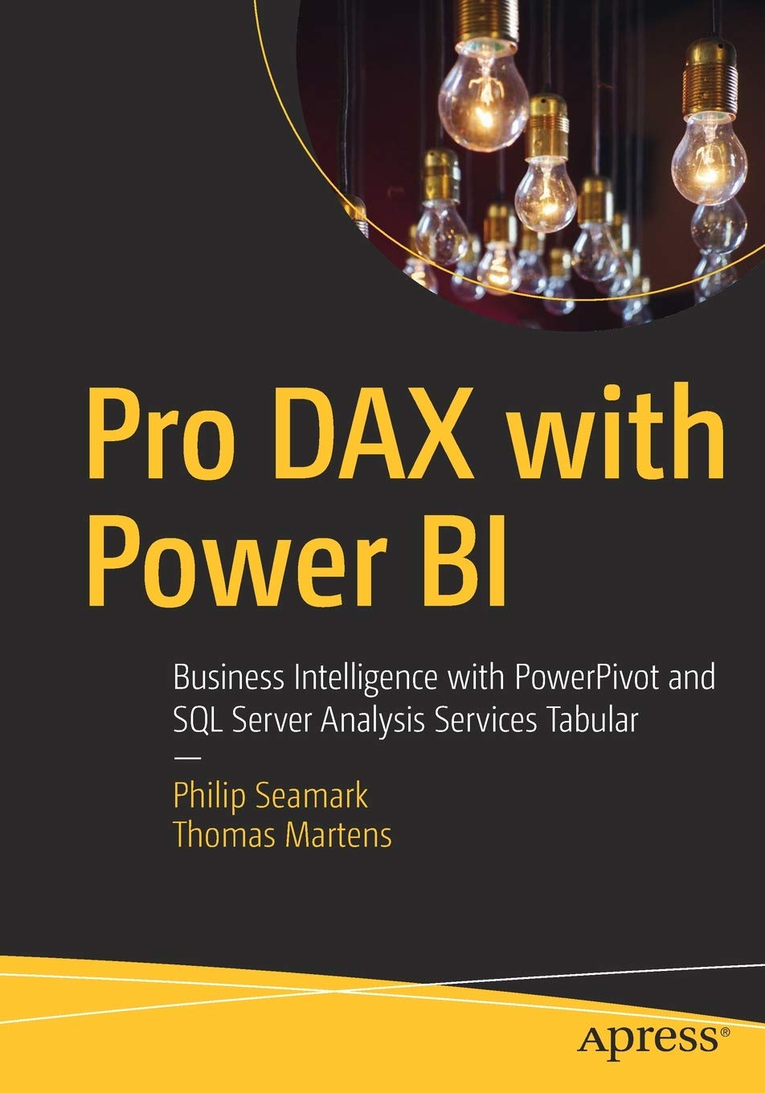

Tom Martens
25+ years of experience designing analytical solutions using the MSFT data platform
Solution Architect @ Munich Re
/tommartens68
@tommartens68

Slide 4

What this session is about

Slide 5
What this session is about
This session is about the new Microsoft Fabric item type Org App and how this new item will help to further share insights inside our team or throughout the entire organization. This new feature or set of capabilities might not seem as important as a lakehouse, but during this session, I will explain why Org apps are not minor but part of a team of heroes. The session starts with a short overview of the workspace app, its history, and its current state. I will provide a short overview of how to use a workspace app properly, including the feature "multiple audiences." But then this session is about the new king, Org Apps (or Organizational Apps). What makes them different (I think a lot), what are their superpowers (there are some), and, of course, their weaknesses (at least for the moment)? This means this will become a tale from integrating new Fabric items like a real-time dashboard and a notebook into an Org App and how the entire organization will benefit from these new item types, but also how we have to adapt our way of deploying (meaning sharing) these insights with our users. This session addresses the Power BI Developer (who is creating this new item type), the Solution Architect (who is architecting an analytical solution), and the Fabric Tenant Administrator (who will oversee the mental and physical health of the Fabric tenant).

Slide 6
What this session is about
This session is about the new Microsoft Fabric item type Org App and how this new item will help to further share insights inside our team or throughout the entire organization. This new feature or set of capabilities might not seem as important as a lakehouse, but during this session, I will explain why Org apps are not minor but part of a team of heroes. The session starts with a short overview of the workspace app, its history, and its current state. I will provide a short overview of how to use a workspace app properly, including the feature "multiple audiences." But then this session is about the new king, Org Apps (or Organizational Apps). What makes them different (I think a lot), what are their superpowers (there are some), and, of course, their weaknesses (at least for the moment)? This means this will become a tale from integrating new Fabric items like a real-time dashboard and a notebook into an Org App and how the entire organization will benefit from these new item types, but also how we have to adapt our way of deploying (meaning sharing) these insights with our users. This session addresses the Power BI Developer (who is creating this new item type), the Solution Architect (who is architecting an analytical solution), and the Fabric Tenant Administrator (who will oversee the mental and physical health of the Fabric tenant).
Notes:
The new content types allow us to address
New audiences (maybe data scientists) that will use the Teams integration (AT THE CURRENT MOMENT ORG APPS ARE NOT AVAILABLE) to comment on notebooks)
Or ”simply” by adding the new content types to existing apps, we are now able to provide new kinds of insights that were not possible before
A mixture of the above

Slide 7
What this session is about
This session is about the new Microsoft Fabric item type Org App and how this new item will help to further share insights inside our team or throughout the entire organization. This new feature or set of capabilities might not seem as important as a lakehouse, but during this session, I will explain why Org apps are not minor but part of a team of heroes. The session starts with a short overview of the workspace app, its history, and its current state. I will provide a short overview of how to use a workspace app properly, including the feature "multiple audiences." But then this session is about the new king, Org Apps (or Organizational Apps). What makes them different (I think a lot), what are their superpowers (there are some), and, of course, their weaknesses (at least for the moment)? This means this will become a tale from integrating new Fabric items like a real-time dashboard and a notebook into an Org App and how the entire organization will benefit from these new item types, but also how we have to adapt our way of deploying (meaning sharing) these insights with our users. This session addresses the Power BI Developer (who is creating this new item type), the Solution Architect (who is architecting an analytical solution), and the Fabric Tenant Administrator (who will oversee the mental and physical health of the Fabric tenant).
Notes:
If a new feature arrives it is always a good idea to know it strengths (superpowers) and its weaknesses
Especially if this feature is similar to an existing feature
Because sometimes the „awaited“ capability comes
With a downside, meaning known capabilities are no longer available

Slide 8
What this session is about
This session is about the new Microsoft Fabric item type Org App and how this new item will help to further share insights inside our team or throughout the entire organization. This new feature or set of capabilities might not seem as important as a lakehouse, but during this session, I will explain why Org apps are not minor but part of a team of heroes. The session starts with a short overview of the workspace app, its history, and its current state. I will provide a short overview of how to use a workspace app properly, including the feature "multiple audiences." But then this session is about the new king, Org Apps (or Organizational Apps). What makes them different (I think a lot), what are their superpowers (there are some), and, of course, their weaknesses (at least for the moment)? This means this will become a tale from integrating new Fabric items like a real-time dashboard and a notebook into an Org App and how the entire organization will benefit from these new item types, but also how we have to adapt our way of deploying (meaning sharing) these insights with our users. This session addresses the Power BI Developer (who is creating this new item type), the Solution Architect (who is architecting an analytical solution), and the Fabric Tenant Administrator (who will oversee the mental and physical health of the Fabric tenant).
Notes:
THE DEVELOPER: Creating an Org app or numerous Org apps is simple
Adding the content
Sharing the app with the audience
➔ only the steps have slightly changed
THE SOLUTION ARCHITECT: envisioning analytical solutions can be
difficult because the audience is different, or
The full set of capabiliites is not known
THE FABRIC ADMIN: simple, enable the Org App feature in the tenant settings

Slide 9

A little recap

Slide 10











Separate the data from the content
Try to use shared datasets, this will not just save resources by reducing the amount of data refreshes.
Data workspace
Content workspace(s)
Create 1 to n content workspaces
This allows to address different audiences consuming the same data but are not using the same content!
Content creators have at least the contributor role assigned in the content workspace
Content creators are connecting to the Power BI dataset
Content creators are not members of the data workspace
Content creators need Build Permission on the dataset
Row Level Security will be honored if data and content workspaces are separated
Create a data workspace and consider a workspace being an Analysis Services Tabular instance!

Slide 11
Separate the data from the content and Multiple Audiences
Try to use shared datasets, this will not just save resources by reducing the amount of data refreshes.
Data workspace
Content workspace(s)
Different groups of users (currently, multiple Audiences per org are not supported)
Create a data workspace and consider a workspace being an Analysis Services Tabular instance!

Slide 12

Live demo

Slide 13
What’s next…

Slide 14
Differences between Workspace Apps & Org Apps
Workspace App
One Workspace App per workspace
Dedicated report/dashboard instances when comparing the workspace and the app (when an existing report is updated, the app has to be updated as well)
Multiple Audiences: one workspace app can target numerous audiences, meaning there is different content per app
Org App
Many Org Apps per workspace
No dedicated instance, updating an existing report will become effective immediately in the app
“Multiple Audiences” is currently not supported with Org Apps
➔ new Content types
Real-time dashboards (based on RTI dashboards)
Fabric notebooks
There are more differences: https://learn.microsoft.com/en-us/power-bi/consumer/org-app-items/org-app-items#key-ways-that-org-app-items-are-different-from-workspace-apps-also-known-as-power-bi-apps

Slide 15
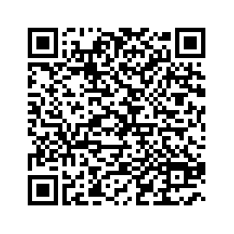
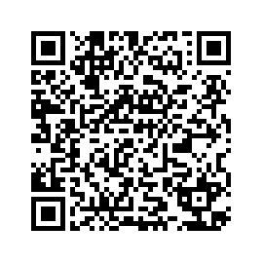
I ask you a favor … Please upvote my ideas
Power BI - Org apps and cross-report drillthrough
Org app and cross-item navigation

Slide 16
What’s new to org apps… (since the launch in November 2024)
More “styling” options regarding navigation inside an app (Preview)
CI/CD (Preview)
Deployment pipelines for org apps
https://powerbi.microsoft.com/en-us/blog/updates-to-org-apps-preview-more-customization-deployment-pipelines-and-git-plus-whats-next-like-new-license-support-and-audiences/

Slide 17
What’s coming next to org apps…
Org apps are coming to Power BI Pro
Paginated reports are coming to org apps
Org apps will be supported on mobile devices
Multiple audiences are coming to org apps (including support of page separation)
https://powerbi.microsoft.com/en-us/blog/updates-to-org-apps-preview-more-customization-deployment-pipelines-and-git-plus-whats-next-like-new-license-support-and-audiences/

Slide 18
One thing I’m really excited about …
During the AMA (Data Science team) on Reddit, I asked the following question:
Will Microsoft Fabric’s Data Agent become an item for the new org app?
The answer: Yes!
Answered by: Nellie Gustafsson (Principal Product lead for Data Science & AI, Microsoft Fabric)
https://www.reddit.com/r/MicrosoftFabric/comments/1karoma/were_the_data_science_team_ask_us_anything/

Slide 19

New content types allow to target new audiences and provide more content but we also have to change our ”way of working.”
Deployment pipelines can replace the ”two instances” approach. This, of course, allows more thorough testing as well.

Slide 20
Resources
Readings
https://learn.microsoft.com/en-us/power-bi/consumer/org-app-items/org-app-items#key-ways-that-org-app-items-are-different-from-workspace-apps-also-known-as-power-bi-apps
https://learn.microsoft.com/en-us/power-bi/consumer/org-app-items/org-app-items
https://learn.microsoft.com/en-us/fabric/data-engineering/notebook-in-app
https://powerbi.microsoft.com/en-us/blog/introducing-org-apps-now-in-public-preview-multiple-apps-per-workspace-custom-colors-and-more/
https://powerbi.microsoft.com/en-us/blog/updates-to-org-apps-preview-more-customization-deployment-pipelines-and-git-plus-whats-next-like-new-license-support-and-audiences/

Slide 21
Thank you!
/tommartens68
@tommartens68

